Slide 1
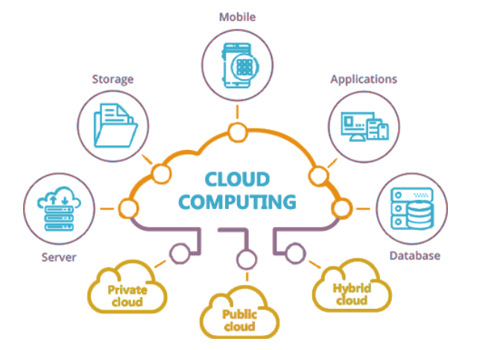
Cloud Computing 101
Ravindu Nirmal Fernando | SLIIT | March 2024
https://ravindunfernando.com

Slide 2
Cloud Computing Principles
Technology is abstracted away from the user.
e.g. hardware and software management is the responsibility of the cloud provider
Location-independent (if you have enough bandwidth)
Cloud Services have a scalable architecture
Dynamic
Request-driven
Clouds have multi-tenancy
Several clients using the same resources

Slide 3
Features of Cloud
Scale and Elasticity
Resource pooling
Location independence
On-demand self-service provisioning
Web services interfaces
Billing and metering services
Monitoring and measuring performance
Providing security to customers

Slide 4
What is Cloud Computing?
Gartner
Cloud computing is a style of computing in which scalable and elastic IT - enabled capabilities are delivered as a service using internet technologies.
Forrester Research
A standardized IT capability (services, software, or infrastructure)delivered in a pay-per-use, self-service way.
NIST
Cloud computing is a model for enabling ubiquitous, convenient, on-demand network access to a shared pool of configurable computing resources (e.g., networks, servers, storage, applications, and services) that can be rapidly provisioned and released with minimal management effort or service provider interaction.

Slide 5
Everything as a Service
Traditionally applications ran on dedicated hardware
Clouds provide everything (hardware, software, applications, etc.) as a service

Slide 6
The Business Case for the Cloud
Supporting business agility
Reducing capital expenditure

Slide 7
Cloud Service/ Delivery Models
Cloud Software as a Service (SaaS)
Use provider’s applications over a network
Cloud Platform as a Service (PaaS)
Deploy customer-created applications to a cloud
Cloud Infrastructure as a Service (IaaS)
Rent processing, storage, network capacity, and other fundamental computing resources
7
Notes:
7
Cloud Software as a Service (SaaS). The capability provided to the consumer is to use the provider’s applications running on a cloud infrastructure and accessible from various client devices through a thin client interface such as a Web browser (e.g., web-based email). The consumer does not manage or control the underlying cloud infrastructure, network, servers, operating systems, storage, or even individual application capabilities, with the possible exception of limited user-specific application configuration settings.
Cloud Platform as a Service (PaaS). The capability provided to the consumer is to deploy onto the cloud infrastructure consumer-created applications using programming languages and tools supported by the provider (e.g., java, python, .Net). The consumer does not manage or control the underlying cloud infrastructure, network, servers, operating systems, or storage, but the consumer has control over the deployed applications and possibly application hosting environment configurations.
Cloud Infrastructure as a Service (IaaS). The capability provided to the consumer is to provision processing, storage, networks, and other fundamental computing resources where the consumer is able to deploy and run arbitrary software, which can include operating systems and applications. The consumer does not manage or control the underlying cloud infrastructure but has control over operating systems, storage, deployed applications, and possibly select networking components (e.g., firewalls, load balancers).

Slide 8
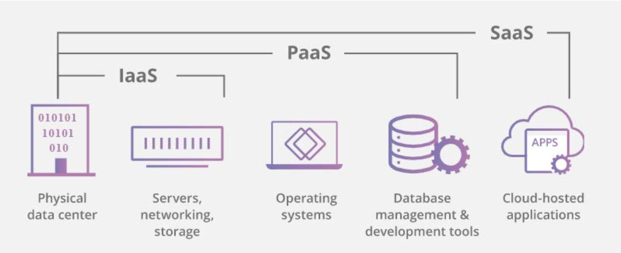

Slide 9
Infrastructure as a Service (IaaS)
Delivery of a compute foundation as a service.
servers
networking technology
storage
data center space
Includes the delivery of
operating systems and
virtualization technology to manage the resources.
Customer rents computing resources rather than buying and installing them
Paid on a usage basis
May include dynamic scaling
Agreed on service level

Slide 10
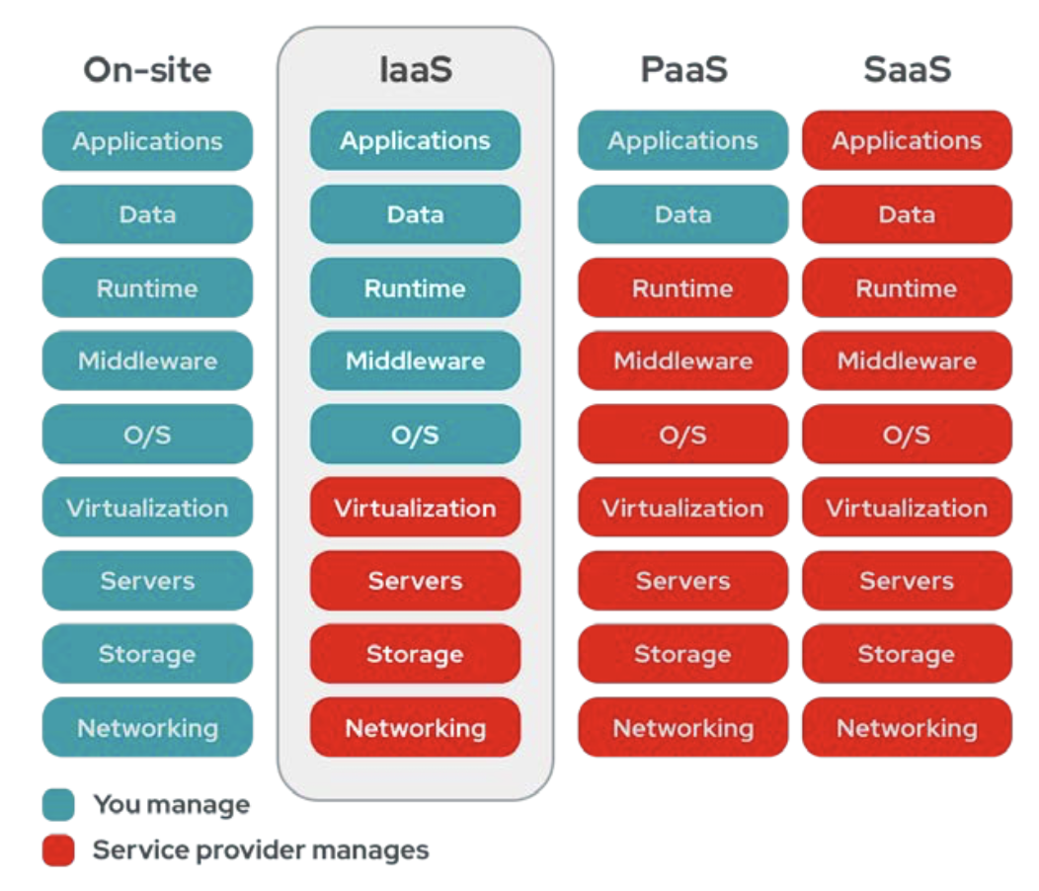
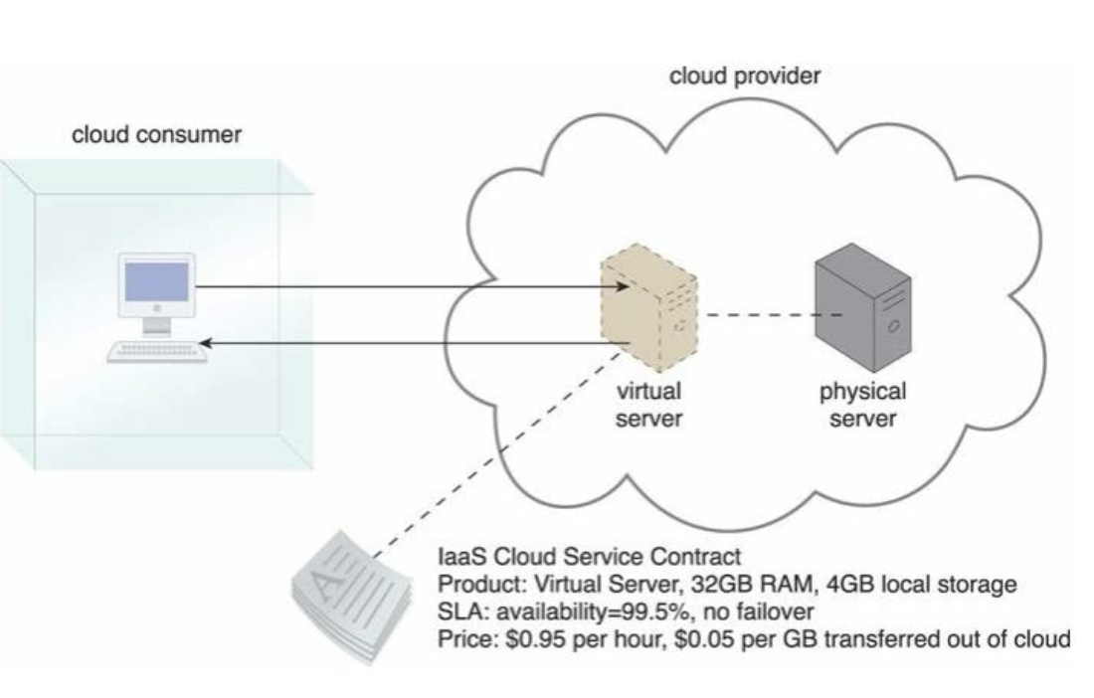

Slide 11
Platform as a Service (PaaS)
Delivers a solution stack (ready-made) for both
software development and
a runtime environment
Easy to develop applications
May be constrained
Danger of lock-in
allow you to focus on the deployment and management of your applications.
Cloud consumer is spared the administrative burden of setting up and maintaining the bare infrastructure IT resources

Slide 12
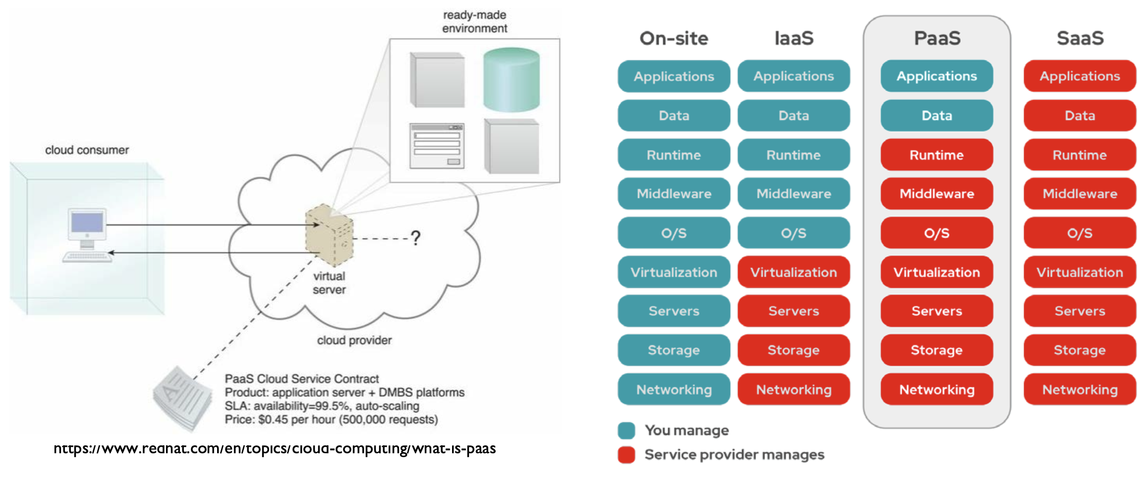

Slide 13
Software as a Service (SaaS)
Service provider offers specific applications offered as a “product”
hosted by the provider
Consumed by the customer
May be customised by the customer
Information stored by the provider
No necessity to purchase any hardware
The SaaS vendor
Operates
Maintains and
Supports all the software, hardware, and communications technology
The price is on a per-use basis and involves no upfront capital costs.

Slide 14
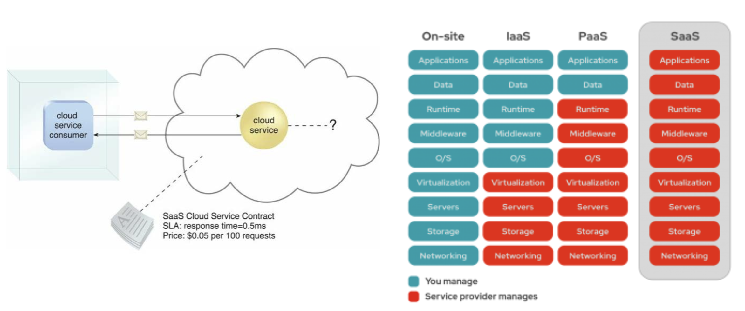

Slide 15
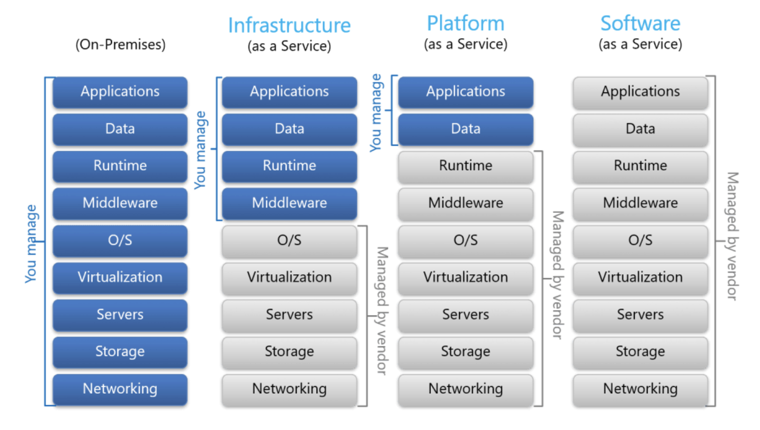

Slide 16
Choosing between IaaS, PaaS, SaaS
IaaS
Flexibility, finer control, & performance
Still need some level of infrastructure maintenance
Scaling, configuration, security
PaaS
Speedy development, better integration, automated scaling, no maintenance needs
Relatively low-customization, Vendor lock-in
SaaS
Fastest for common applications
Little customization

Slide 17
Cloud service/ delivery models variations
Many specialized variations of the three base cloud delivery models have emerged
Storage as a Service
Database as a Service
Security as a Service
Communication as a Service
Integration as a Service
Testing as a Service
Process as a Service

Slide 18
Cloud Deployment Models
Private cloud
enterprise owned or leased. Resources are dedicated to enterprise
Public cloud
Sold to the public, mega-scale infrastructure
Hybrid cloud
composition of two or more clouds. Mostly deployment between public and private
Community cloud
shared infrastructure for specific community
Personal cloud
your own cloud – belongs to you
18
Notes:
18
Private cloud. The cloud infrastructure is operated solely for an organization. It may be managed by the organization or a third party and may exist on premise or off premise.
Community cloud. The cloud infrastructure is shared by several organizations and supports a specific community that has shared concerns (e.g., mission, security requirements, policy, and compliance considerations). It may be managed by the organizations or a third party and may exist on premise or off premise.
Public cloud. The cloud infrastructure is made available to the general public or a large industry group and is owned by an organization selling cloud services.
Hybrid cloud. The cloud infrastructure is a composition of two or more clouds (private, community, or public) that remain unique entities but are bound together by standardized or proprietary technology that enables data and application portability (e.g., cloud bursting).

Slide 19
Common Cloud Characteristics
Cloud computing often leverages:
Massive scale
Virtualization
Resilient computing
Low cost software
Geographic distribution
Service orientation
Advanced security technologies
19
Notes:
19

Slide 20
Selection of a Cloud Service
Know what you want first
What services are available?
What is your pricing model?
What are your scaling options?
What are your security measures?
Where are your datacenters located?
What are SLA terms?
Customer support
Reputation

Slide 21
References
https://www.cloudflare.com/learning/cloud/what-is-the-cloud/
https://www.redhat.com/en/topics/cloud-computing/what-is-iaas
https://www.redhat.com/en/topics/cloud-computing/what-is-paas
https://www.redhat.com/en/topics/cloud-computing/what-is-saas
Cloud Computing: Concepts, Technology & Architecture, Thomas Erl, et al., Prentice‐Hall, 2013,
The Datacenter as a Computer – Designing Warehouse‐Scale Machines, 3rd Edition, Morgan & Claypool Publishers, 2019
Cloud design patterns: Prescriptive architecture guidance for cloud applications, Homer, Alex, et al. , 2014.

